Slide 1

COMP 4920 Senior Project Design Project Presentation, Fall 2021 Project Code: #DRONOMATRIX Project Name: CYBER DRONE 4 June 2021, Version 1.0
Bora GÜZEL
Ege Erberk USLU
Simge Binnaz ÖZDEMİR
Supervisor: Dr. Mutlu BEYAZIT
Department of Computer Engineering
Yaşar University

Slide 2

ACKNOWLEDGEMENTS
We would like to thank our supervisor, Mutlu BEYAZIT, who supported us throughout the project, and to all our teachers who have been with us until today.

Slide 3
OUTLINE
Motivation
Project Aim
Related work
General Introduction
System Design & Interaction
Aspects of the project that can be improved
Conclusion

Slide 4
MOTIVATION
Most realistic drone simulation environment on Unity.
Realistic weather and effects.
Realistic drone movement and 360 degree perspective.

Slide 5
PROJECT AIM
Implementing a realistic simulation environment.
Reduce the cost of damage caused by the user and environmental conditions.
Realistically training drone pilots.
Can be used in aviation system training.

Slide 6
BEST EXAMPLES PREVIOUSLY PRESENTED
Name | Company | Type
DJI Flight Simulator | RembelTech | Real simulator
DRL Simulator | Drone Racing League | Video Game
Real Flight Drone Edition | Real Flight | Video Game
Phoenix RC 5.5 (PC Windows) | Phoenix RC | Video Game
LiftOff Drone Simulator (PC Windows) | LuGus Studios | Video Game

Slide 7
GENERAL INTRODUCTION
Realistic simulator
Drone customization
Weather effects
Map selection
Single Player/Multiplayer mode
Web Administration

Slide 8
SYSTEM DESIGN & INTERACTION
Unity
-Simulation environment
-Maps
-Drones
-Weather effects
-Single/Multiplayer mode
Web Administration
-User Management
-Log Management
-Data Management
Online User System

Slide 9
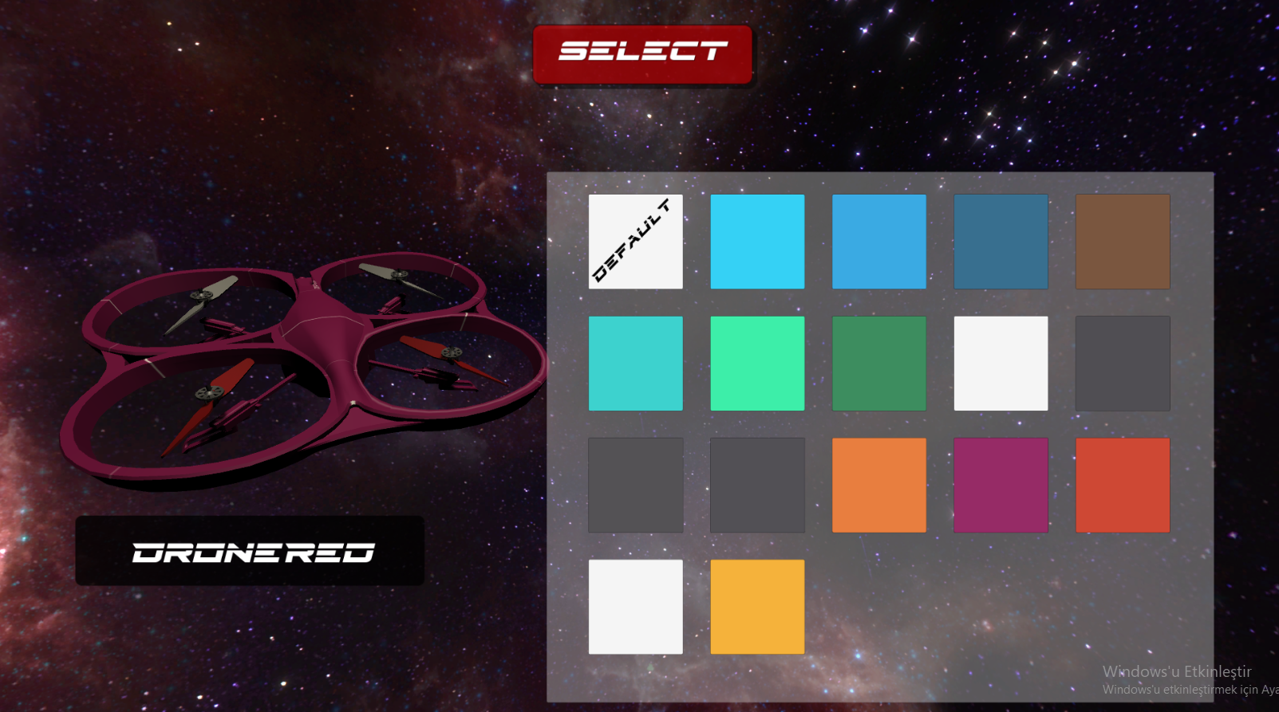
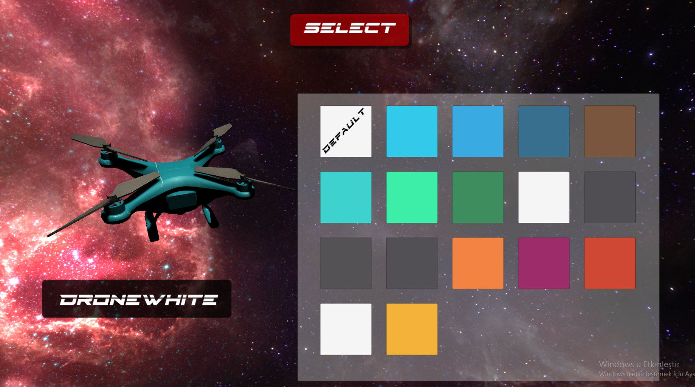
DRONE CUSTOMIZATION
In the customization page, you can customize your drone with 17 different color
Each drone can be customizable with these options

Slide 10
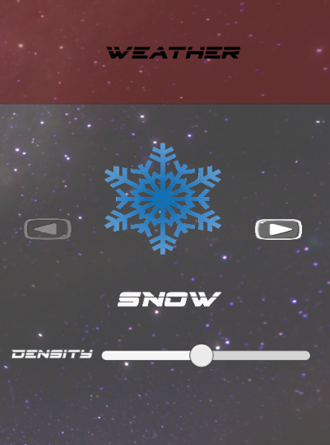
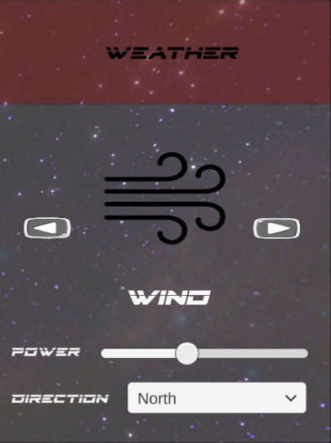
WEATHER EFFECTS
There is four different weather option
Snow with density Rain with density
Wind with direction and power Sunny
Weather effects the gameplay and visual wise

Slide 11
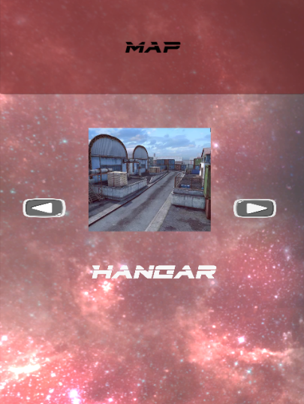
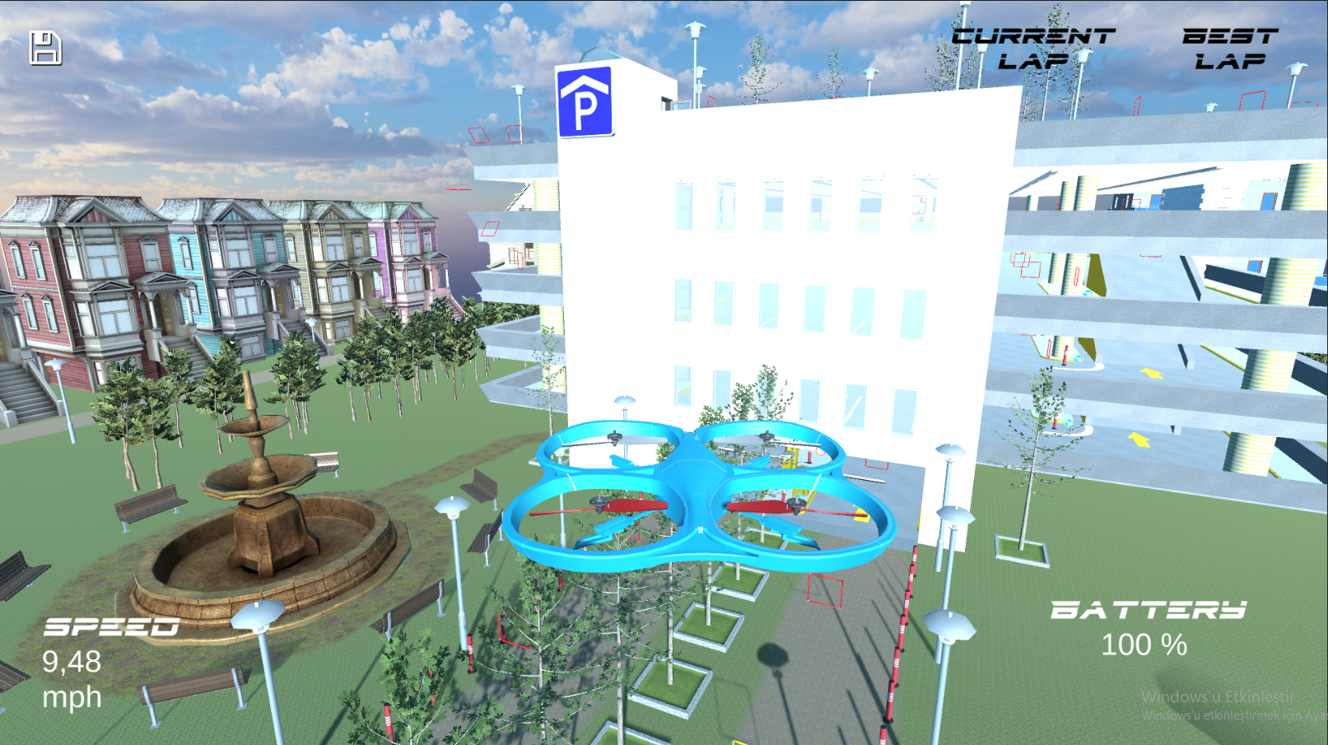
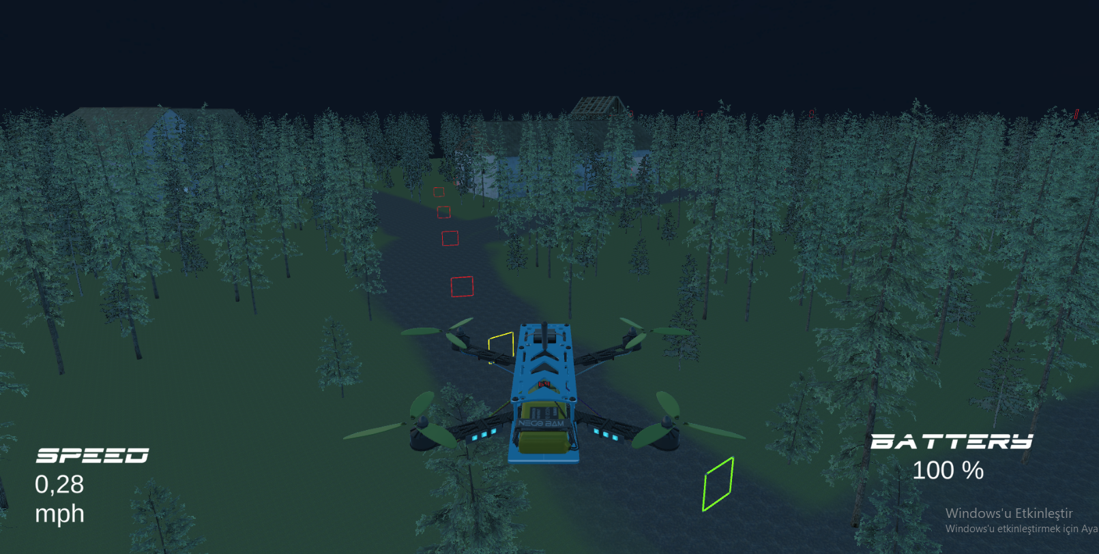
MAP SELECTION
There are six different maps
Three introduction level and three normal level
Each level is different from each other

Slide 12
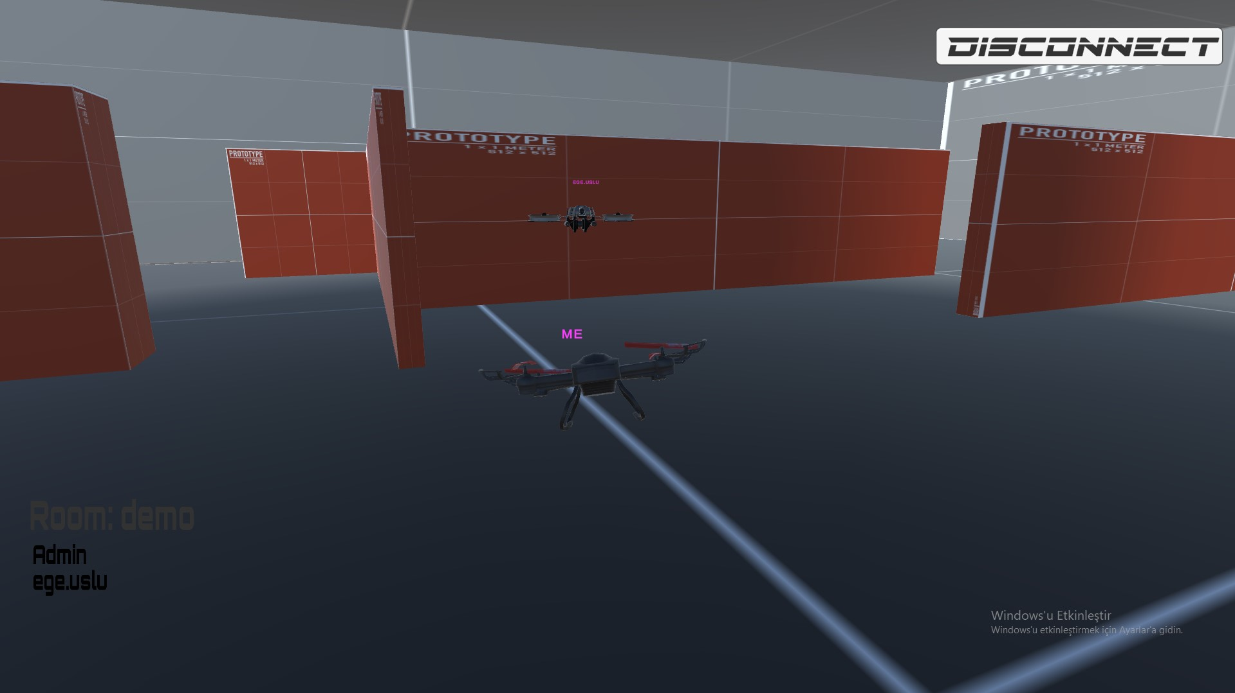
UNITY MULTIPLAYER
Photon Network
Create & Join Room
Leave Room
Drone Selection

Slide 13
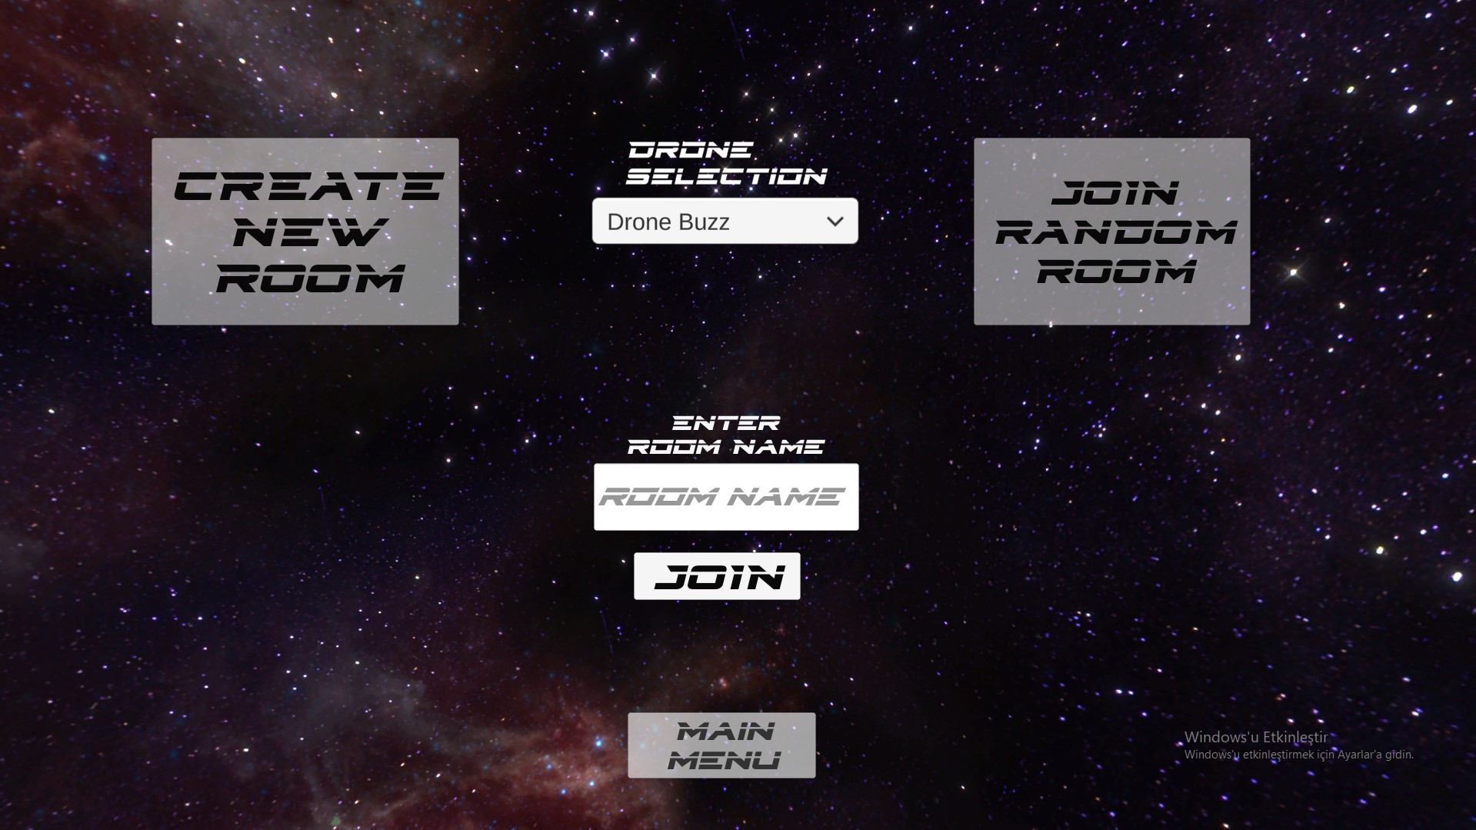
UNITY MULTIPLAYER
Room Info
Player List
Player Tag Name
Free style

Slide 14
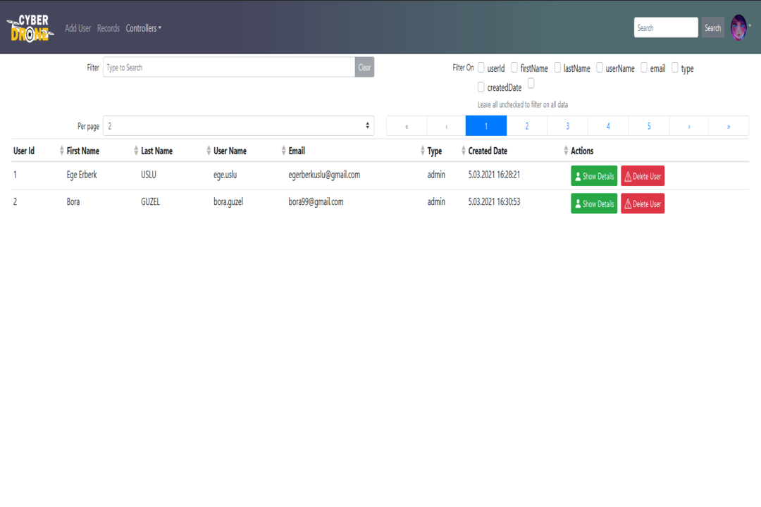
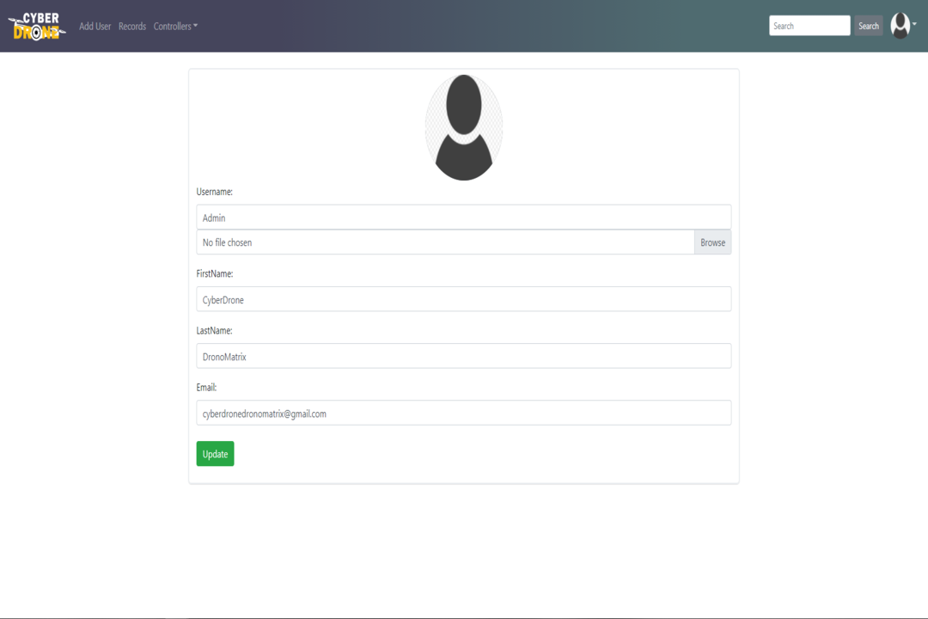
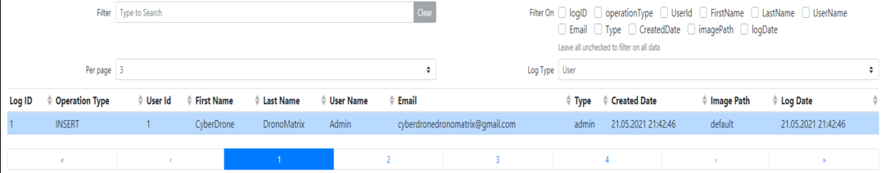
WEB ADMINISTRATION
Secure Login
Online Users
Forget Password
Change Password
Managing Users
Accessing Records
Bug Reports
Logs

Slide 15

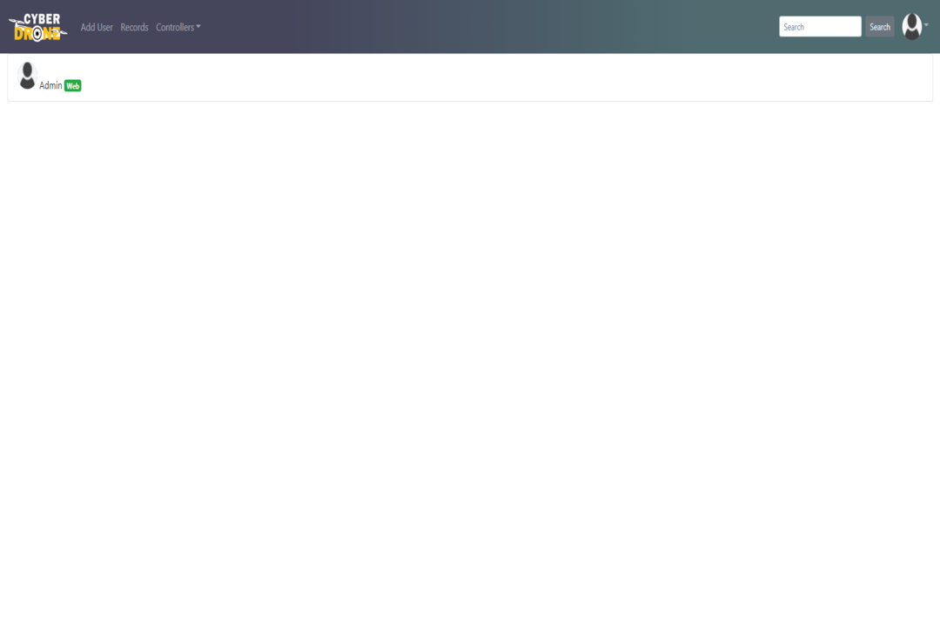

SECURE LOGIN
ONLINE USERS
Shows Users
Simulation and Web
Online User Server
RSA
SHA256
AES

Slide 16

FORGET PASSWORD
CHANGE PASSWORD
New Generated Password
Send email to User
New Password to system.

Slide 17

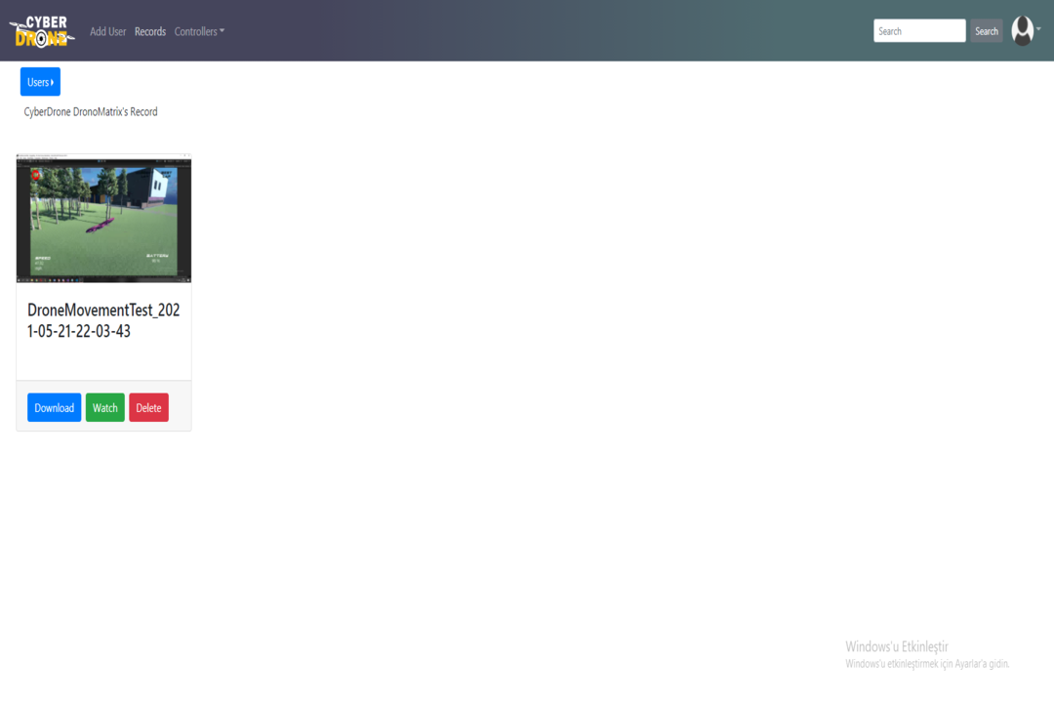
MANAGING USERS
ACCESING RECORDS
CRUD operations
Changing Credentials
Watching
Downloading

Slide 18

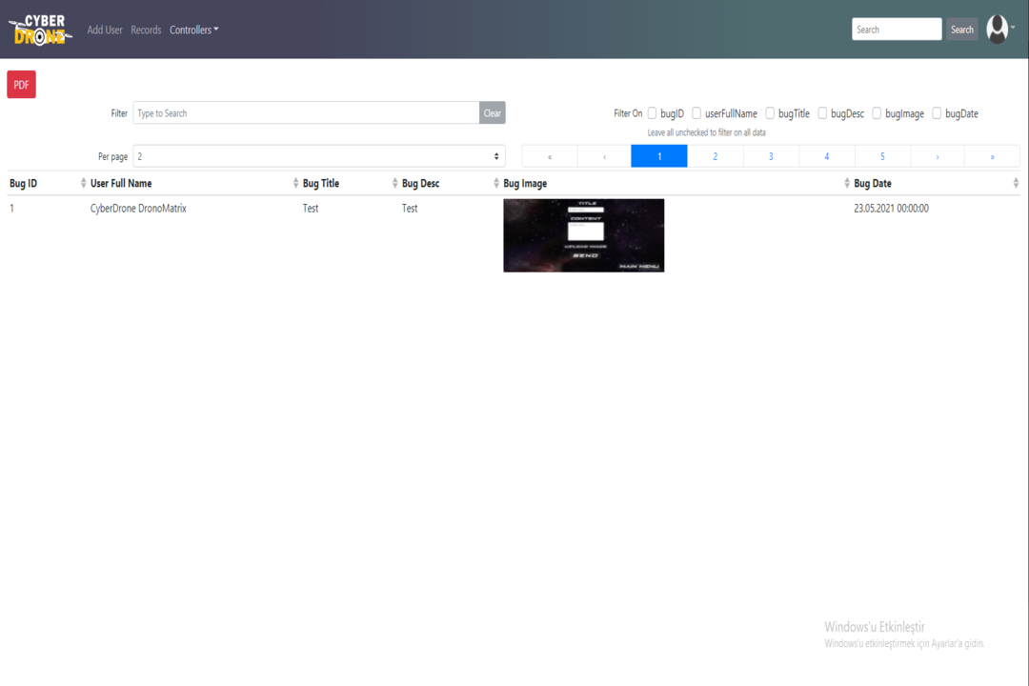
BUG REPORT
LOGS
Accessing Reported Bugs
Exporting them in PDF
User Logs
Record Logs
Bug Logs

Slide 19
FUTURE WORK
In future;
Adding more maps & weather conditions.
As a drone compiler simulator.
Multiplayer lobby system & friend list.
More realistic movement with Physics Engine
Improvement for swarm drones.

Slide 20
CONCLUSION
Single/Multiplayer mode simulation system
Different maps / different conditions
Realistic Drone Movement
Web-Unity integrated system
Usage Area -> Drone pilots , Space and aviation systems, Game Industry

Slide 21
REFERENCES
https://www.raywenderlich.com/1142814-introduction-to-multiplayer-games-with-unity-and-photon
https://www.youtube.com/watch?v=XMYhzJvm1bg
https://www.youtube.com/watch?v=wyvHe4DLN50
https://www.red-gate.com/simple-talk/dotnet/c-programming/creating-multiplayer-games-with-unity-and-pun/
https://www.wired.com/2017/05/the-physics-of-drones/
https://www.rembeltech.com/dji-flight-simulator/
https://www.dronmarket.com/blog/icerik/en-iyi-5-drone-simulasyonu

Slide 22
Q & A
Simge Binnaz Özdemir-17070001001 simgebinnazozdemir@hotmail.com
Ege Erberk Uslu-16070001006 egerberkuslu@gmail.com
Bora Güzel-17070001010 boraguzel99@hotmail.com

